Slide 1

UNIVERSITY OF PETROLEUM AND ENERGY STUDIES DEHRADUN
MINOR- I
Comparative Study of Ant Colony Optimization Algorithm on Travelling Salesman Problem
SUBMITTED BY:-
Harshit Gupta
500062804 (R164217020)
Divyank Kargeti
500062838 (R164217017)
B. TECH. CSE-IoT&SC (SEMESTER V)
UNDER THE GUIDANCE OF:-
Mr. Adarsh Kumar
Associate Professor
Department of Systemics
School of Computer Science

Slide 2
ABSTRACT
E-commerce organizations have a separate department to handle logistics for timely delivery of products ordered by their customers.The process, after the order has been accepted and is to be dispatched, begins with collection of goods from the warehouse and doorstep delivery via optimized path calculation, factoring in the essential components like fuel economy, load, and quantity.Hence, this automation leads to profitability, and reduction in cost of resources being used. An accurate way to calculate this path is via the Travelling-Salesman Problem by W.R. Hamilton.
Keywords: Travelling-Salesman, Hamiltonian Cycle, E-commerce, Optimization

Slide 3
PROBLEM STATEMENT
The main challenge in doing this project is to optimize the cost of the logistics system by devising an algorithm which involves minimum space and time. We will take orders from multiple users, from a specific city and take the respective addresses to calculate the optimized path of delivery.

Slide 4
PROJECT OBJECTIVES
OBJECTIVE 1:
To have an understanding of algorithm used.
objective 2:
To understand the working of delivery routing systems used by the logistics staff in an e-commerce organization, and to demonstrate the methodology used by this algorithm.

Slide 5
INTRODUCTION
In the travelling-salesman problem, which is closely related to the Hamiltonian cycle problem, a salesman must visit n cities. Modeling the problem as a complete graph with n vertices, we can say that the salesman wishes to make a tour, visiting each city exactly once and finishing at the city he starts from. The salesman incurs a nonnegative integer cost c(A,B) to travel from city A to city B, and he wishes for this cost to be minimum, where the total cost is the sum of the individual costs along the edges of the tour
Modifying the problem to sectors in a city and cost as fuel, the staff for logistics shall have an optimized path with economical fuel expense. Given the functionalities of programming language C, a possible implementation is with the defined complexity of O (n²*2^{n})

Slide 6
PSEUDOCODE: BELLMAN-HELD-KARP
function algorithm TSP (G, n)
for k := 2 to n do
C({k}, k) := d_{1,k}
end for
for s := 2 to n-1 do
for all S ⊆ {2, . . . , n}, |S| = s do
for all k ∈ S do
C(S, k) := min_{m≠k}, m∈S [C(S\{k}, m) + d_{m,k}]
end for
end for
end for
opt := min_{k≠1} [C({2, 3, . . . , n}, k) + d_{k,1}]
return (opt)
end

Slide 7
ALGORITHM USED: BELLMAN-HELD-KARP ALGORITHM
The algorithm belongs to Dynamic Programming in TSP, and is the most efficient algorithm to be implemented for solving it:
Take one starting vertex x arbitrarily
For the set of vertices S belonging to V\{S}, vertex v is in S, let:
B(S,V) = minimum length of path, that:
Starts in S
Visits S and all vertices in S (and no other vertices)
Ends in V
B({v},v) = d(s,v)
For j = 2 to |V| - 1:
For all sets S, |S| = j for all v belonging to S:
B(s,v) = min_{w-S\(v)}{B(S\{V},w}) + d(w,v)}
Return min{B(V\{s},v) + d(v,s) | v belongs to V}
The total running time is therefore O (n²*2^{n}).

Slide 8
BELLMAN-HELD-KARP ALGORITHM ANALYSIS
The key points of analysis of Bellman-Held-Karp Algorithm are as follows:
It is the most efficient algorithm to solve the TSP dynamically
The time complexity of this algorithm is O (n²*2^{n})
The space complexity of this algorithm is O (n*2^{n})

Slide 9
OTHER ALGORITHMS
BRUTE FORCE SEARCH
NEAREST NEIGHBOR (NN) ALGORITHM
CHRISTOFIDE'S ALGORITHM
ANT COLONEY OPTIMIZATION ALGORITHM

Slide 10

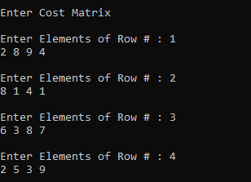
WORKFLOW
This Project follows the following Process :
The program asks the User to enter 'Total number of cities needed to be covered'
The program now asks the User to enter 'Cost matrix'

Slide 11
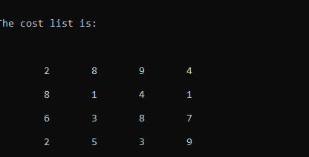


The program now displays 'Cost Matrix' on the output screen as entered by the user.
The program calculates and displays 'Shortest Path' on the output screen.
The program displays 'Minimum Cost and Total Time Spent ' on the output screen.

Slide 12
OUTPUT
SCREEN

Slide 13
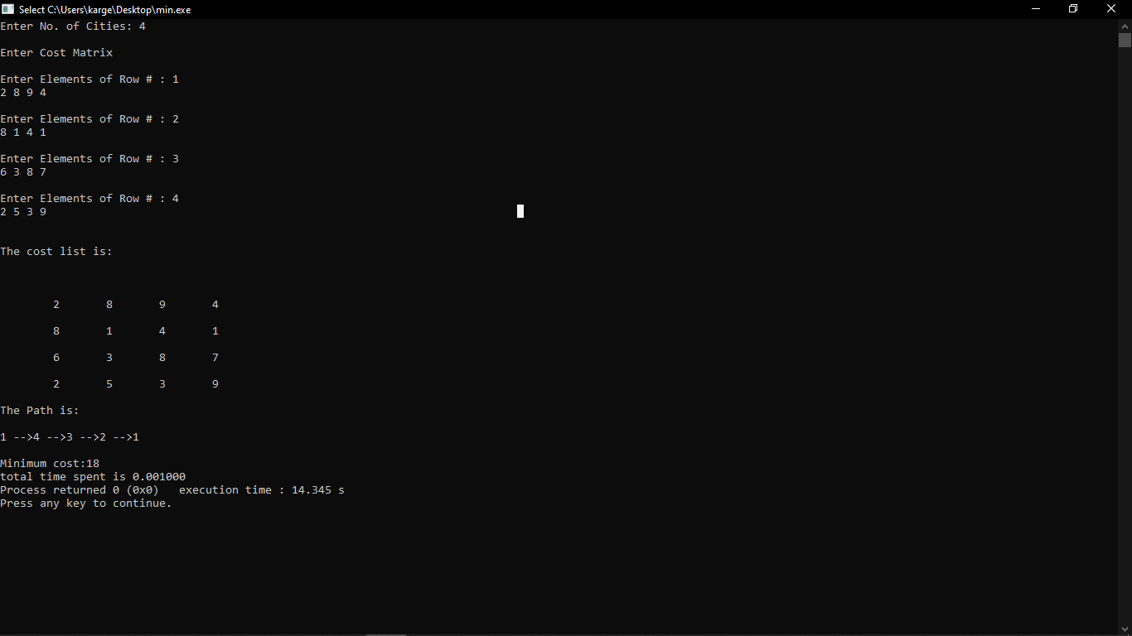

Slide 14
Ant Colony Optimization (ACO)
General optimization problem:
given f:X->ℝ,
find xεX such that f(x) is minimum.
Given a graph with two specified vertices A and B, find a shortest path from A to B.
Given a set of cities and pairwise distances, find a shortest tour

Slide 15
Abstract
In the real world, ants (initially) wander randomly, and upon finding food return to their colony while laying down pheromone trails. If other ants find such a path, they are likely not to keep traveling at random, but instead follow the trail laid by earlier ants, returning and reinforcing it if they eventually find food.
Over time, however, the pheromone trail starts to evaporate, thus reducing its attractive strength. The more time it takes for an ant to travel down the path and back again, the more time the pheromones have to evaporate.
A short path, by comparison, gets marched over faster, and thus the pheromone density remains high

Slide 16
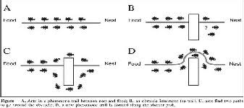
Shortest Route
Shortest route is found using pheromone trails which ants deposit whenever they travel, as a form of indirect communication

Slide 17
ACO algorithm
The process starts by generating m random ants (solution).
An ant k (k=1,2…….,m) represents a solution string, with a selected value for each variable.
An ant is evaluated according to an objective function.
Accordingly, pheromone concentration associated with each possible route( variable value) is changed in a way to reinforce good solutions as follows:

Slide 18
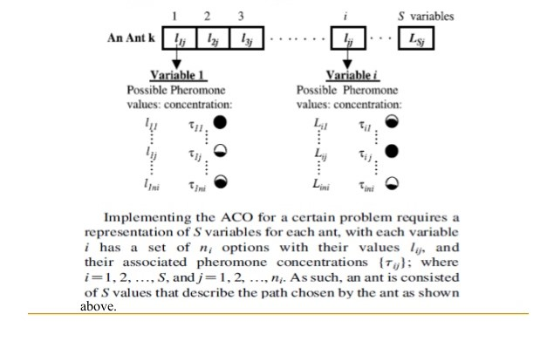
ACO algorithm Implementation

Slide 19
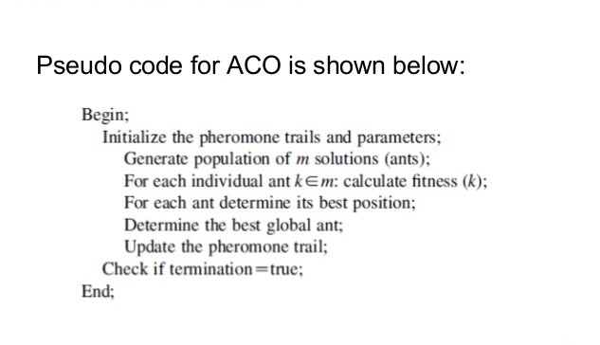
ACO Pseudo Code

Slide 20
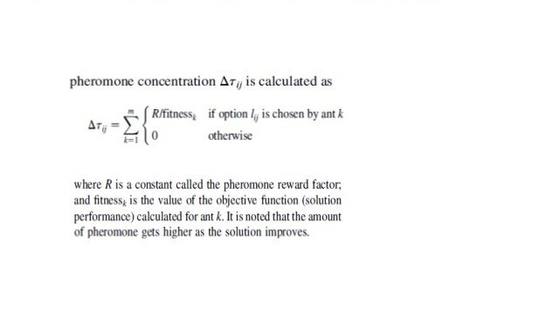
Pheromone Concentration Calculation

Slide 21
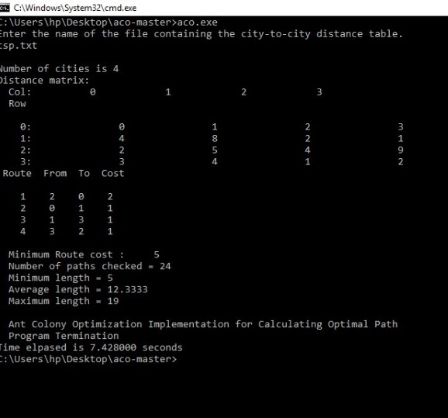
OUTPUT SCREEN FOR ACO

Slide 22
REFERENCES
T.H. Cormen, C.E. Leiserson, R.R. Rivest, C. Stein. Introduction to Algorithms: Third Edition. The MIT Press, Cambridge, Massachusetts, London, England
Cook, William J. In Pursuit of the Traveling Salesman: Mathematics at the Limit of Computation. Princeton, NJ: Princeton UP, 2012 [Print]
C. Brucato. “The Travelling Salesman Problem,” 2013, pp. 10-14
C. Woodford. “E-Commerce.” Internet: https://www.explainthatstuff.com/ecommerce.html, Sept. 14, 2016 [Sept. 06, 2018]
Emad Elbeltagi, Tarek Hegazy, Donald Grierson, Comparison among five evolutionary-based optimized algorithm, 19 January 2005,Advanced Engineering informatics 19 (2005) 43-53
“E-commerce Logistics in Supply Chain Management: Practice Perspective,” 2016, pp. 179-185
K.K. Aggarwal, Y. Singh. Software Engineering: Third Edition. New Age International Publishers, Dariya Ganj, New Delhi, Delhi
S.K. Pal. “Software Engineering | Iterative Waterfall Model.” Internet: https://www.geeksforgeeks.org/software-engineering-iterative-waterfall-model, Aug. 26, 2016

Slide 23
THANK YOU!

